Slide 1
data wrangling with r
Welcome!

Slide 2

introductions

Slide 3
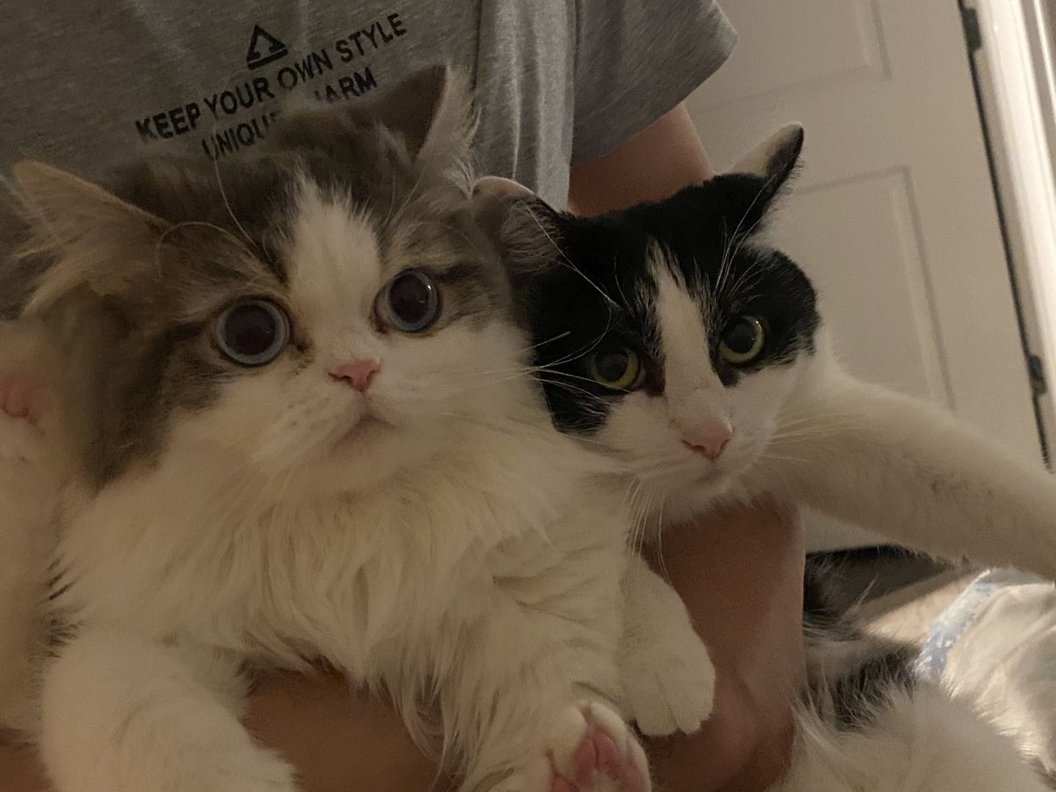

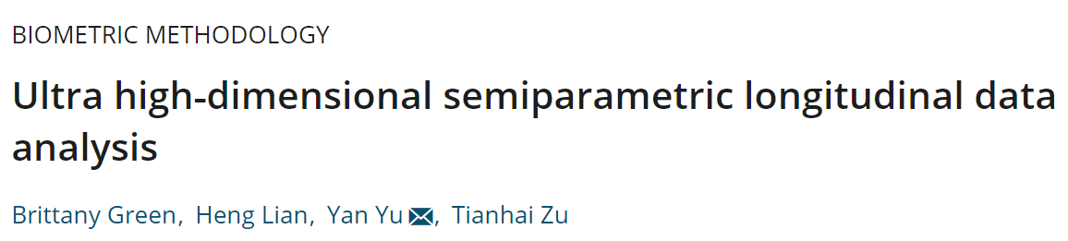



Instructor:
Tianhai Zu has
Two cats
Some papers
A lot of Questions

Slide 4

course objectives
Perform your data analysis in a literate programming environment
Import and manage structured and unstructured data
Manipulate, transform, and summarize your data
Join disparate data sources
Methodically explore and visualize your data
Perform iterative functions
Write your own functions
Get an introduction to machine learning
…all with R!

Slide 5
Lots of hands-on coding exercises

Slide 6

You will be overwhelmed!

Slide 7
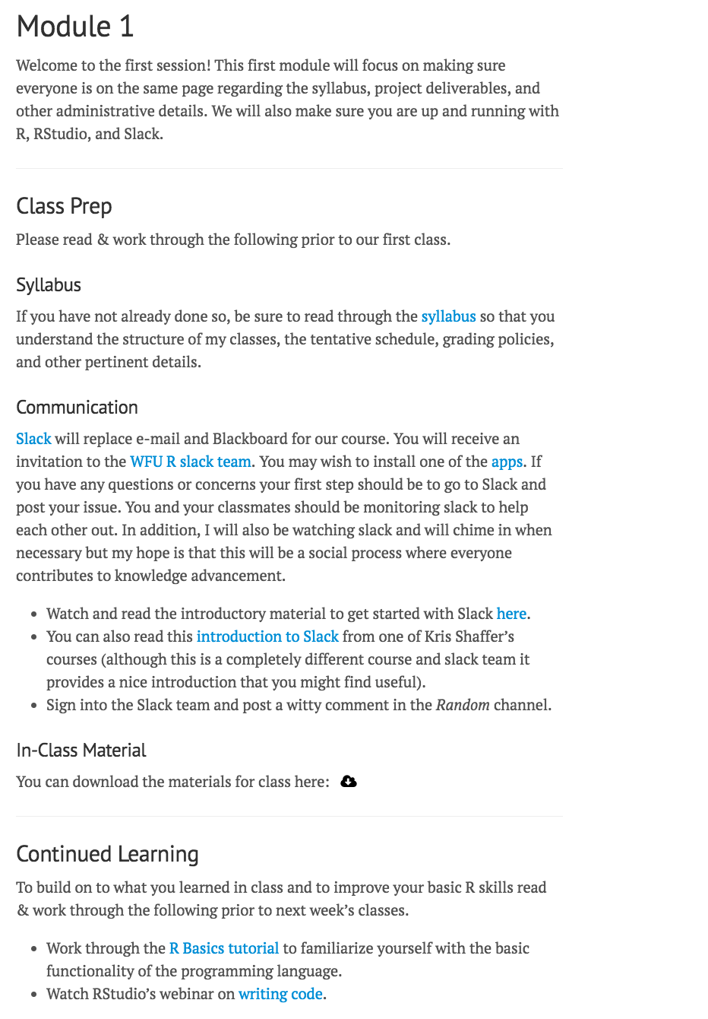
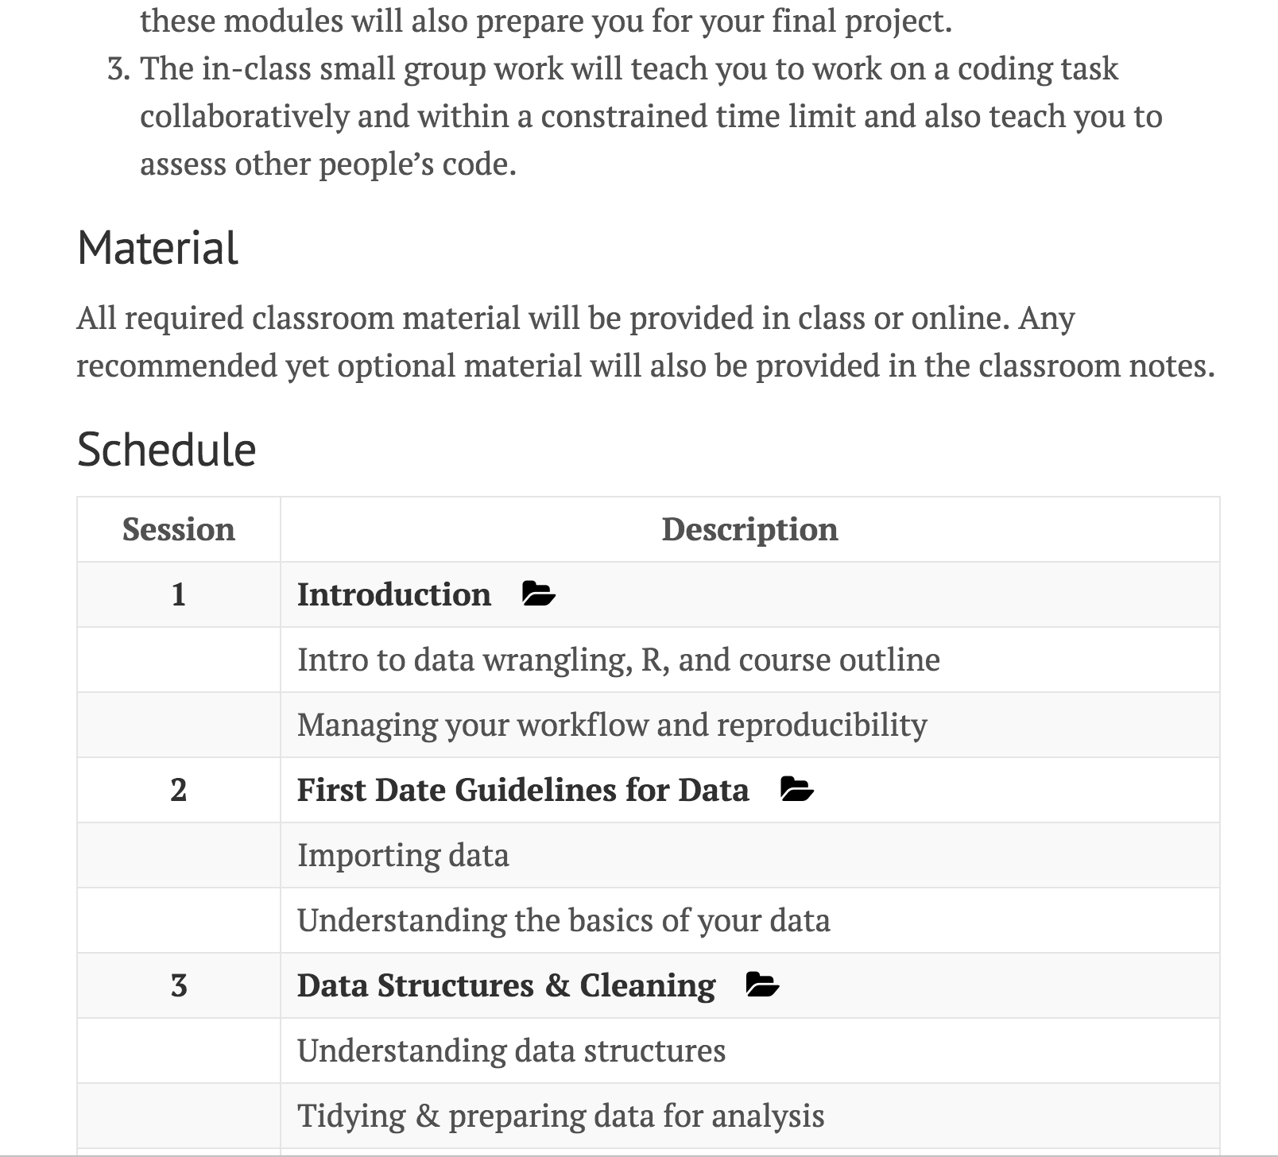
class material
https://zzz1990771.github.io/data_wrangling
All material online
Tutorials, resources, & exercises
Any info regarding class prep

Slide 8
class grading
Engagement 10%
Homework Assignments 20%
In class discussion
Slack discussions
Must be completed by Sun @ 1159pm
individual homeworks!
Submit via Canopy
Mid-term Project Eval 20%
Final Project 50%
HTML report via R Markdown
Completes items 1.1-3.5 of the grading rubric
Helps to build your final project
Fully reproducible HTML report
Imports, cleans, prepares, explores publicly available data
Helps to build your portfolio

Slide 9
TENTATIVE schedule
Week | Date | Topic | Readings to complete BEFORE class | Due
1 | October 12 | Introduction & Base R • Intro to the course, R, and RStudio • Base R and Data Cleaning
2 | October 19 | First Date Guidelines for Data • Reproducible documents and workflow management • Importing data and getting to know it | Chapter 27 of R for Data Science (R4DS), sections 27.1 through 27.5 | Homework #1 (Due OCT 18 @ 11:59PM)
3 | October 26 | Tidy Data and Data Manipulation • Tidying & preparing data for analysis • Data manipulation | Chapter 12 of R4DS, sections 12.1 through 12.5 Chapter 5 of R4DS, sections 5.1 through 5.4 | Homework #2 (Due OCT 25 @ 11:59PM)
4 | November 2 | Data Transformation • Relational data • Leveraging the Tidyverse to simplify data wrangling | Chapter 5 of R4DS, sections 5.5 through 5.7 | Mid-term Project Evaluation (Due Nov 1 @ 11:59PM)
5 | November 9 | Data Visualization • Data visualizations | Chapter 3 of R4DS, all sections | Homework #3 (Due NOV 8 @ 11:59PM)
6 | November 16 | Creating Efficient Code • Control statements and iterations • Writing functions | Chapter 19 of R4DS, sections 19.1 through 19.6 Chapter 21 of R4DS, sections 21.1 through 21.5 | Homework #4 (Due NOV 15 @ 11:59PM)
7 |  | Introduction to Applied Modeling • Unsupervised learning • Supervised learning | Chapter 22 of R4DS, all sections Chapter 23 of R4DS, all sections | Final Project Due (TBD)

Slide 10
TENTATIVE schedule
Week | Date | Topic | Readings to complete BEFORE class | Due
1 | October 12 | Introduction & Base R • Intro to the course, R, and RStudio • Base R and Data Cleaning
2 | October 19 | First Date Guidelines for Data • Reproducible documents and workflow management • Importing data and getting to know it | Chapter 27 of R for Data Science (R4DS), sections 27.1 through 27.5 | Homework #1 (Due OCT 18 @ 11:59PM)
3 | October 26 | Tidy Data and Data Manipulation • Tidying & preparing data for analysis • Data manipulation | Chapter 12 of R4DS, sections 12.1 through 12.5 Chapter 5 of R4DS, sections 5.1 through 5.4 | Homework #2 (Due OCT 25 @ 11:59PM)
4 | November 2 | Data Transformation • Relational data • Leveraging the Tidyverse to simplify data wrangling | Chapter 5 of R4DS, sections 5.5 through 5.7 | Mid-term Project Evaluation (Due Nov 1 @ 11:59PM)
5 | November 9 | Data Visualization • Data visualizations | Chapter 3 of R4DS, all sections | Homework #3 (Due NOV 8 @ 11:59PM)
6 | November 16 | Creating Efficient Code • Control statements and iterations • Writing functions | Chapter 19 of R4DS, sections 19.1 through 19.6 Chapter 21 of R4DS, sections 21.1 through 21.5 | Homework #4 (Due NOV 15 @ 11:59PM)
7 |  | Introduction to Applied Modeling • Unsupervised learning • Supervised learning | Chapter 22 of R4DS, all sections Chapter 23 of R4DS, all sections | Final Project Due (TBD)

Slide 11

Programming & Analysis
Download and install R, a free software environment for statistical computing and graphics from CRAN, the Comprehensive R Archive Network. It is highly recommended to install a precompiled binary distribution for your operating system; follow these instructions:
Go to https://cran.r-project.org/
Click “Download R for Mac/Windows”
Download the appropriate file:
Windows users click Base, and download the installer for the latest R version
Mac users select the file R-3.X.X.pkg that aligns with your OS version
Follow the instructions of the installer.

Slide 12

Programming & Analysis
Install RStudio’s IDE (stands for integrated development environment), a powerful user interface for R. RStudio includes a text editor, so you do not have to install another stand-alone editor. Follow these instructions:
Go to RStudio for desktop https://www.rstudio.com/products/rstudio/download/
Select the install file for your OS
Follow the instructions of the installer.
There are other R IDE’s available: Emacs, Microsoft R Open, Notepad++, etc; however, I have found RStudio to be my preferred route. When you are done installing RStudio click on the icon.

Slide 13

questions about the class?

Slide 14

fundamentals

Slide 15
OVERVIEW OF the RStudio IDE
Thorough tutorial regarding the RStudio console: http://dss.princeton.edu/training/RStudio101.pdf

Slide 16
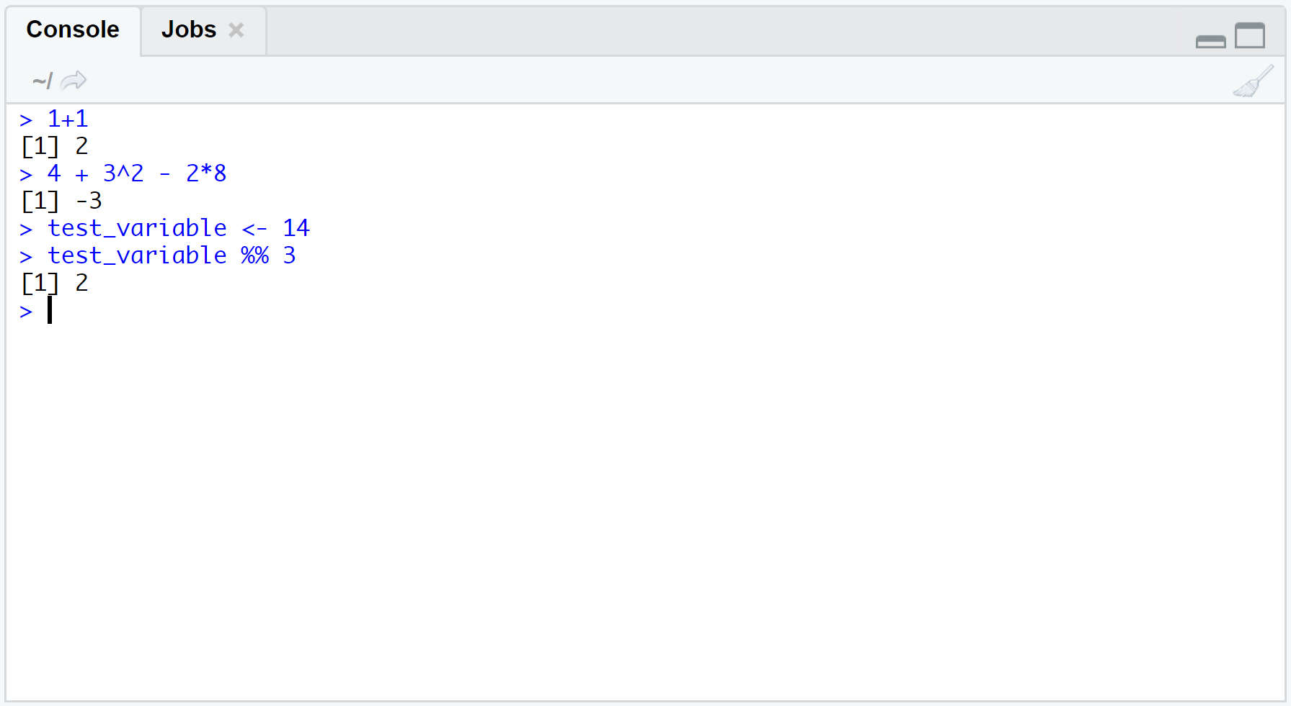
the RStudio CONSOLE
Can type commands, arithmetic, functions, and other things here
DOES NOT save code for future RStudio sessions
> symbol means the command you typed begins here
The [1] means the first value of the command’s results begins here

Slide 17
Your turn!
Type the following command into the console. What does the : operator in R do?
2:173
Type exactly what you see below in the console and then press Return.
table(iris$Species
Then type a right parenthesis and press Return. What’s happening?

Slide 18
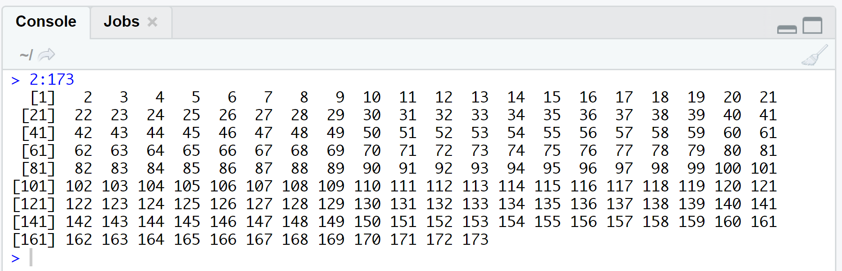
Solution
Create a vector of integers starting at 2 and ending with 173. (What do the numbers in brackets mean?)

Slide 19
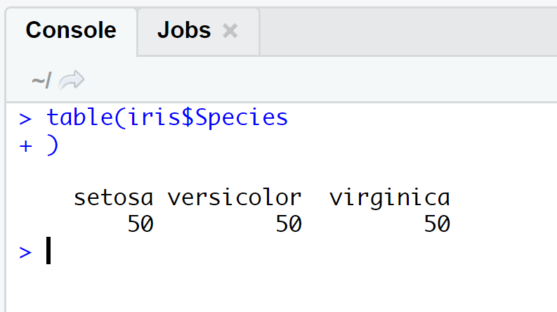
Solution
R displays a + prompt in the console if you type an incomplete command.
No big deal—Complete the command or press Escape to start a new command.

Slide 20
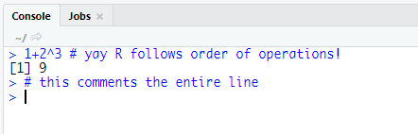
Other fun console stuff
Use # to comment part of a line or the entire line (get ready to comment way too much this semester)
Use the STOP button on top of the console (or CTRL + c) to cancel a command
You can change preferences by going to Tools→Global Options

Slide 21
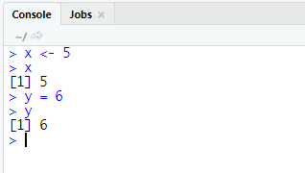
Storing Objects
Use the <- assignment operator to store objects as variables.
The Tidyverse Style Guide suggests using <- for the assignment operator instead of =
Yes, you can use either. But…
<- is typically used for assigning values to variables
= is typically used for specifying parameter values in functions
Type the variable’s name and press Return to display the variable’s value after assignment

Slide 22
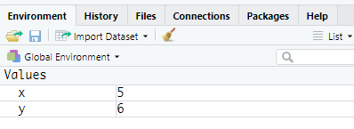
MORE ON Storing Objects
Variables appear in the Environment pane after assignment
Variable names must:
Begin with a letter or a period (there’s more to this)
Only contain letters, digits, periods, and underscores
Reserved words in R cannot be used (e.g., TRUE)
Tidyverse Style Guide: use snake case for variable names

Slide 23
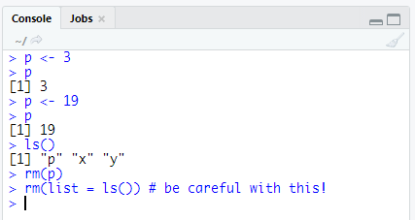
EVEN MORE ON Storing Objects
Keyboard shortcut for the <- assignment operator: ALT + -
R is case sensitive!
R overwrites variable names
Use ls() to list all object names
Use rm() to remove objects

Slide 24
Your turn!
Create a vector of integers from 1 to 30 (inclusive). Call it integer_vector.
Use the command c(0,1) to create a separate two-element vector consisting of 0 and 1. Call it binary_flag. (What does the c() function do?)
Multiply your two vectors. What do you notice?

Slide 25
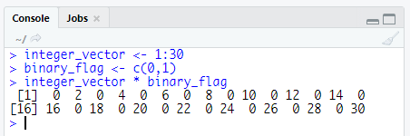
Solution
R performs element-wise execution, recycling vectors as needed.

Slide 26
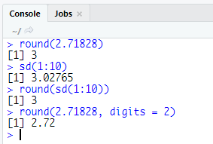
FUNCTIONS
Type the function name and enter value(s)/data in the parentheses
Data passed into a function is called the function’s argument
Arguments can be results from another function
Use = to specify names of arguments, especially with multiple arguments for readability/QA

Slide 27
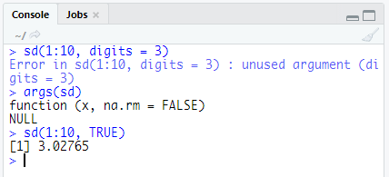
MORE ON FUNCTION ARGUMENTS
R yells at you throws an error when you specify an unknown argument
Use args() to look up a functions arguments
Unless you specify arguments by name, R matches values to arguments in the function by order

Slide 28
Getting help
# provides details for specific function
help(sqrt) OR ?sqrt
# provides examples for said function
example(sqrt)
# search help documentation if you forget the function’s name
??sqr
External to R:
Google: just add "with R" at the end of any search.
Stack Overflow: a searchable Q&A site oriented toward programming issues. 75% of my answers come from SO
Cross Validated: a searchable Q&A site oriented toward statistical analysis.
R-bloggers: a central hub of content from over 500 bloggers who provide news and tutorials about R.

Slide 29
Your turn!
Look at documentation for the quantile function. What does the na.rm argument do?
Use the quantile function to find the 25th and 75th percentiles of the integers 1 through 297.

Slide 30
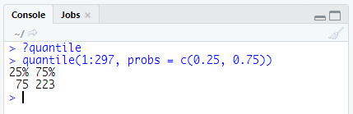
Solution

Slide 31
Scripts
Place code in a script to save for later use/editing/additions
Open a new script by going to File→New File→R Script
Different ways to run code in a script
Clicking the Run button to execute the line of code the cursor is on (or the line(s) of code that you highlighted)
Ctrl + Enter to run the line/block of code that’s highlighted or that the cursor is on
Run the entire script by pressing the Source button

Slide 32
set your working directory
# get your current working directory
getwd()
[1] "/Users/justinjodrey/Dropbox/Academia/UC/BANA7025"
# set your working directory
setwd("/Users/justinjodrey/Dropbox/Academia/UC/BANA7025")
getwd()
[1] "/Users/justinjodrey/Dropbox/Academia/UC/BANA7025"
Keeping your files organized is critical

Slide 33
Your turn!
Set your working directory to the “Session 01” folder you downloaded for this class.

Slide 34
PACKAGES
Everything we’ve discussed so far is considered “base R”, which means we do not require additional capabilities to use these functions
Packages are collections of custom functions and objects that extend the capabilities of base R
Examples of packages you may have seen already:
dplyr (useful for data manipulation)
ggplot2 (useful for visualization)

Slide 35
INSTALLING Packages
The fundamental unit of shareable code is the package.
CRAN: 10,000+
Bioconductor: 1,000+
GitHub: Many more plus beta versions for updated packages not yet published
So how do we install these packages?
# install packages from CRAN
install.packages("packagename")
# install packages from Bioconductor
source("http://bioconductor.org/biocLite.R") # only required the first time
biocLite() # only required the first time
biocLite("packagename")
# install packages from GitHub
install.packages("devtools") # only required the first time
devtools::install_github("username/packagename")

Slide 36
Your turn!
Install these packages from CRAN:
dplyr
nycflights13

Slide 37
Solution
install.packages("tidyverse")
install.packages("nycflights13")
# alternative
install.packages(c(“tidyverse”, “nycflights13”))
For a full list of useful packages see this guide: http://bit.ly/1x9vkzV

Slide 38
I installed a package. Now what?
Installing packages simply downloads them onto your hard drive.
Now you need to load these packages in order to leverage their capabilities.
Important difference!
You only need to install a package once (assuming the package hasn’t changed).
You need to load a package every time you start an RStudio session.

Slide 39
LOADING Packages
Loading packages:
# load the package to use in the current R session
library(tidyverse)
# use a particular function within a package without loading the package
stringr::str_replace()
Getting help on packages:
# provides details regarding contents of a package
help(package = "tidyr")
# list vignettes available for a specific package
vignette(package = "tidyr")
browseVignettes(“KraljicMatrix”)
# view specific vignette
vignette(“tidy-data")

Slide 40
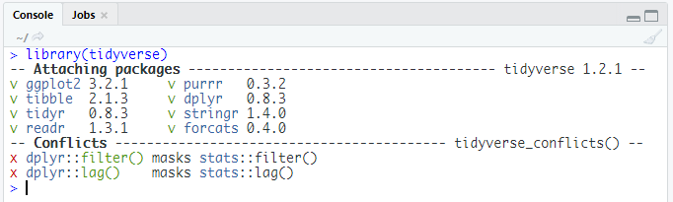
Read warnings when loading packages!

Slide 41

R Objects

Slide 42
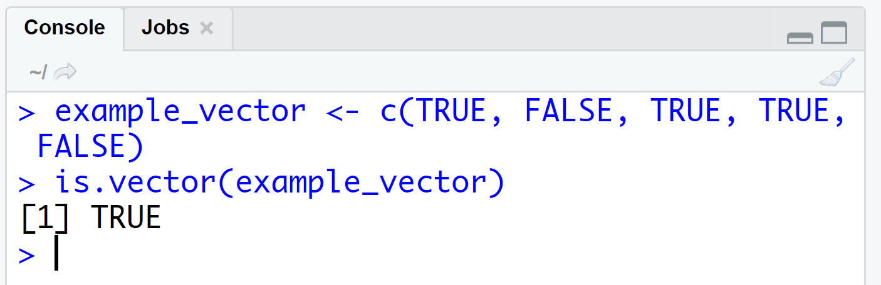
What are atomic vectors?
The simplest data structure in R
Linear vectors of a single data type
Use is.vector() to test if an object is an atomic vector

Slide 43
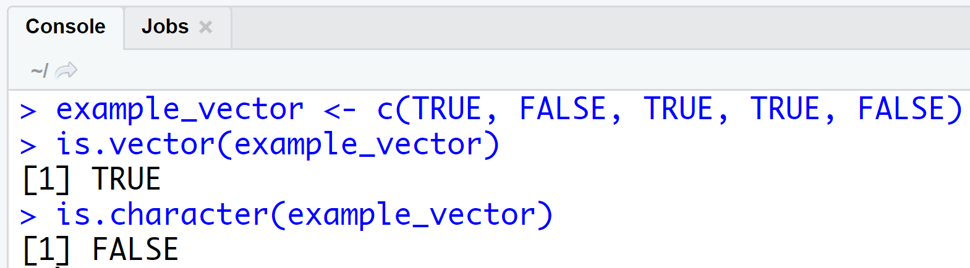
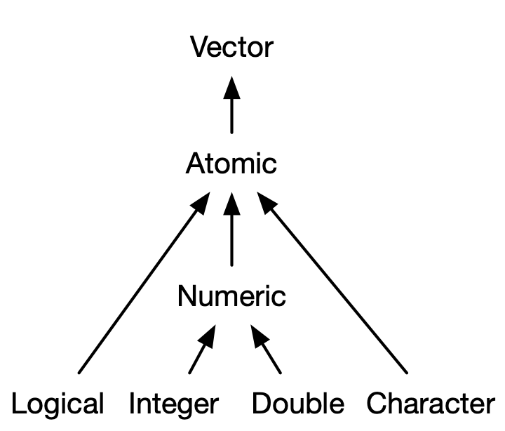
What are atomic vectors?
Four (actually there are six) types of atomic vectors
Some R functions (and most people) refer to doubles as numerics
Use is.*() to test if an atomic vector is a certain data type

Slide 44
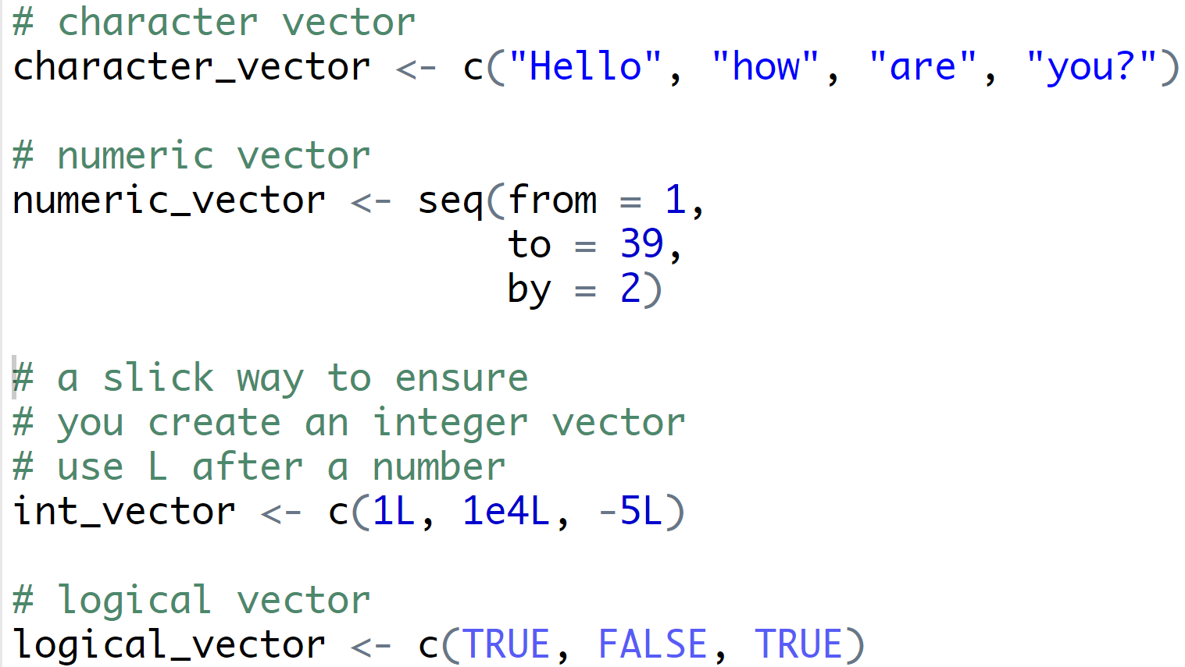
Creating vectors
Use the c() function to combine values into a vector (or a list)
Can use many operators or functions to create numeric vectors
Integers are stored as numerics by default. Use an uppercase L after each integer to store as an integer.

Slide 45
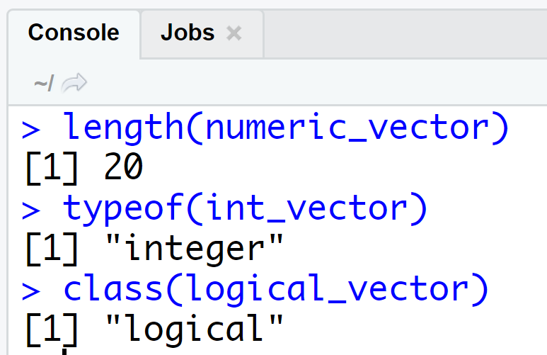
QA Every day! Check vectors
Use length() to find the number of elements a vector has
Use typeof() or class() to identify the type of atomic vector

Slide 46
Your turn!
Look at documentation for the runif() function.
In your script for today’s class, create a vector with 75 observations that come from a uniform distribution with a minimum value of -3 and a maximum value of 14. (Don’t forget to assign this vector to a variable. You pick the name!)
Write functions to examine this vector:
Is it an atomic vector?
What kind of vector is it?
How long is the vector?

Slide 47
Solution
# look at documentation
?runif
help(runif)
args(runif)
# create vector
runif_vector <- runif(n = 75,
min = -3,
max = 14)
# examine the vector
is.vector(runif_vector)
typeof(runif_vector) OR class(runif_vector)
length(runif_vector)

Slide 48
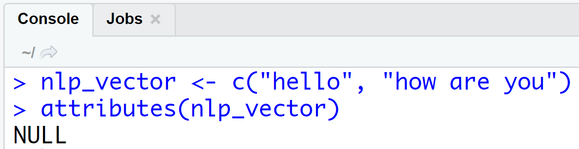
ATTRIBUTES
Attributes are information you can attach to an R object
Attributes will not appear when displaying an object or affect object values
Check for attributes with attributes()

Slide 49
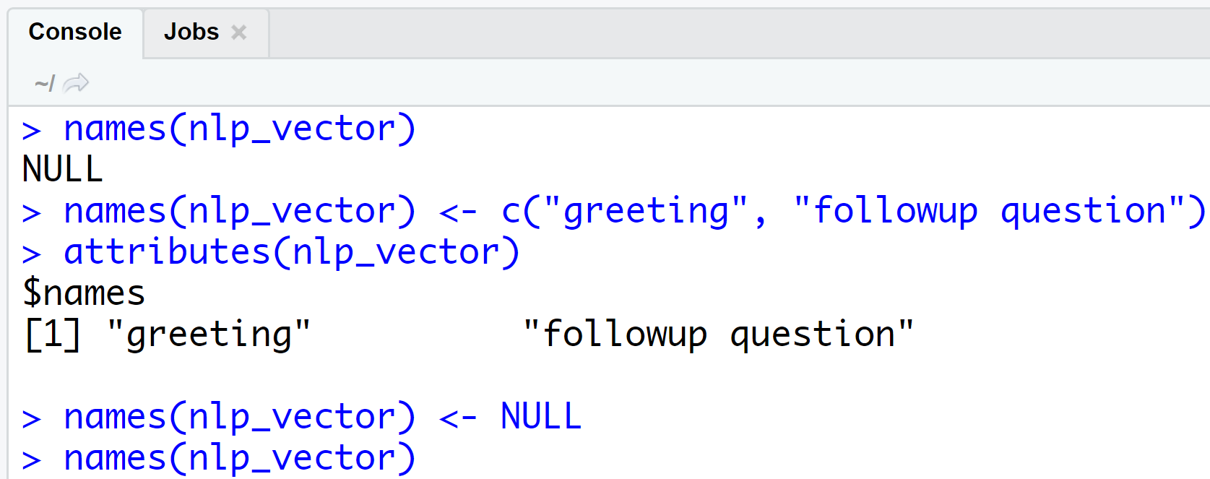
The names ATTRIBUTE
View the names of each element with names()
Assign or change names with (usually) a character vector
Remove value names by assigning a NULL (missing) value to names

Slide 50
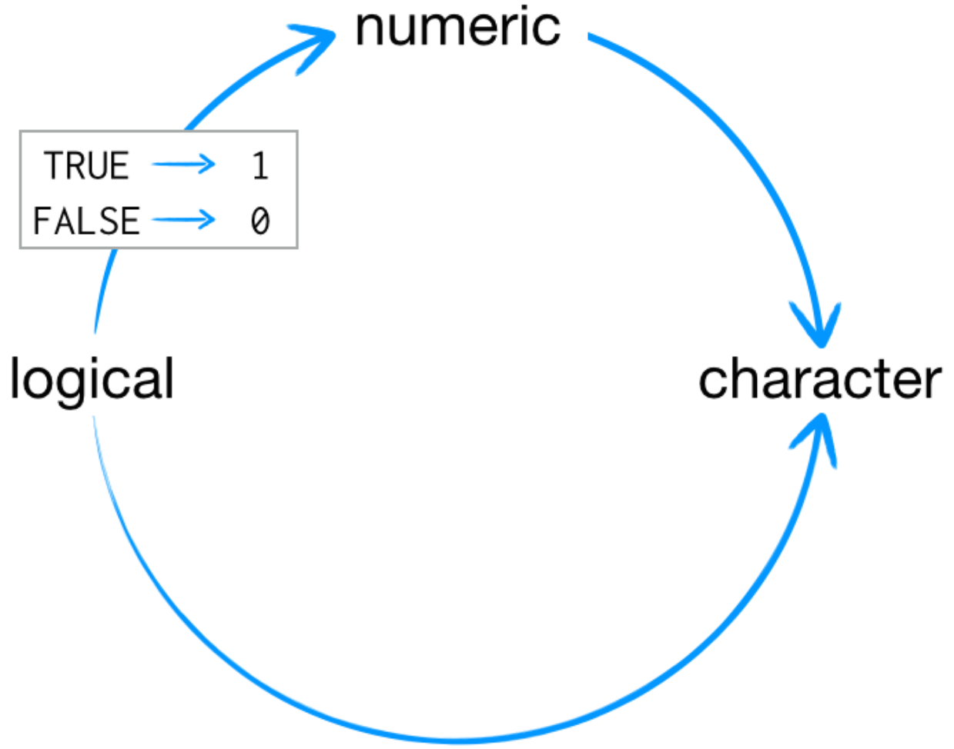
VECTOR COERCION
Combining different data types or forcing functions on certain data types results in coercion
Vector coercion in R always follows a predetermined procedure

Slide 51
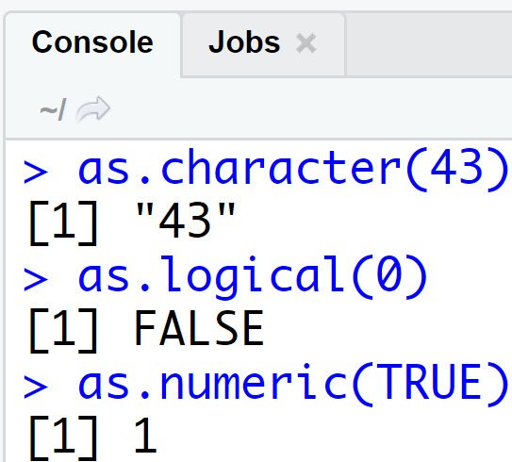
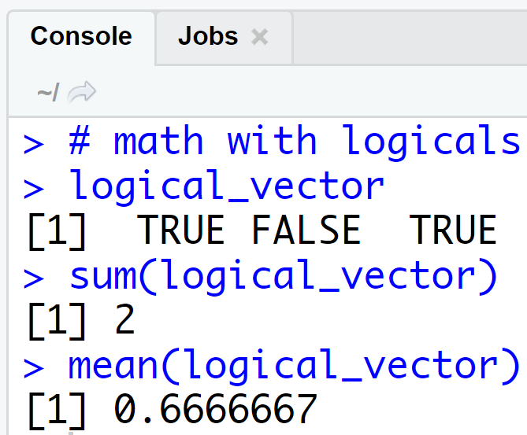
VECTOR COERCION Examples
Forcing functions on data types coerces vectors
Vector coercion isn’t always a bad thing!

Slide 52
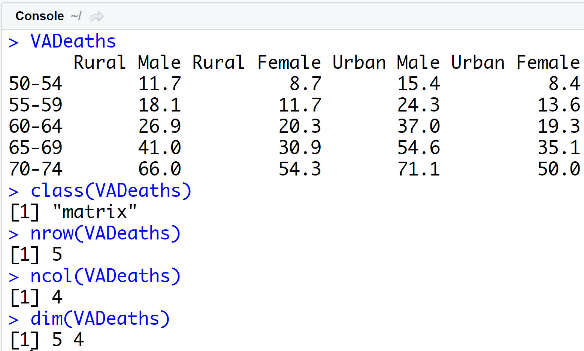
FUNDAMENTAL DATA STRUCTURE
Matrix
Two-dimensional array
Numeric data only
Use the matrix() function to create a matrix

Slide 53
Your turn!
Look at documentation for the matrix() function.
Create a 5x4 matrix of the integers from 1 to 20, filling by rows. Save the matrix as a variable called example_matrix.
Examine the names, class, and dimensions of this matrix.

Slide 54
Solution
# documentation for matrix()
?matrix
# create the matrix
example_matrix <- matrix(
data = 1:20,
nrow = 5,
ncol = 4,
byrow = TRUE
)
# examine attributes
names(example_matrix)
class(example_matrix)
dim(example_matrix)

Slide 55
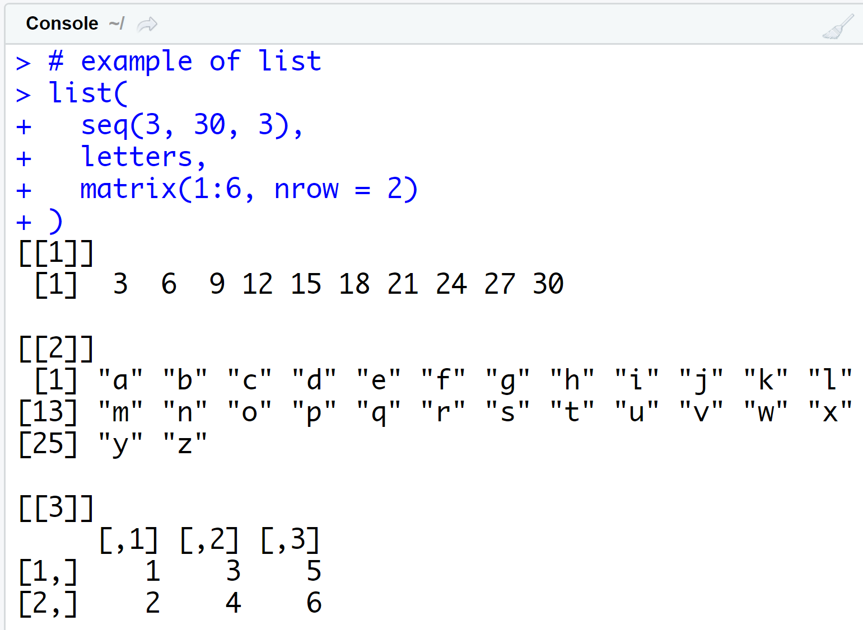
FUNDAMENTAL DATA STRUCTURE
List
One dimension
Each element can be its own object (a vector, matrix, data frame, or even a list)
Use the list() function to create a list
You’ll see lists frequently with linear models

Slide 56
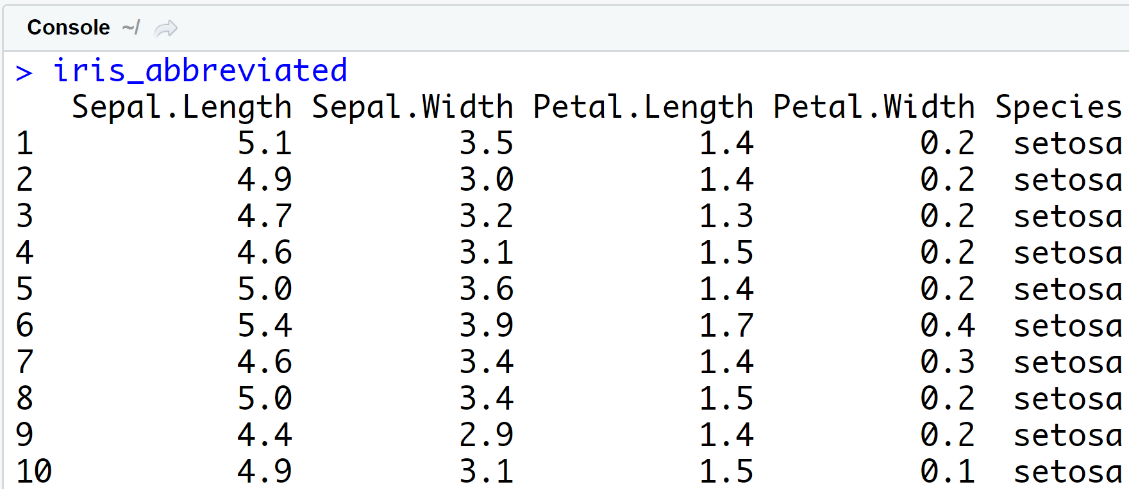
FUNDAMENTAL DATA STRUCTURE
Data Frame
Two-dimension version of a list (think of a spreadsheet)
Named list of vectors with specific attributes
Each vector become a column
Vectors (i.e., columns) must be the same length in a data frame

Slide 57
FUNDAMENTAL DATA STRUCTURE
Data Frame
Use the data.frame() function to create a data frame
Data frames have a special data.frame class
Use str() to examine the structure of a data frame

Slide 58
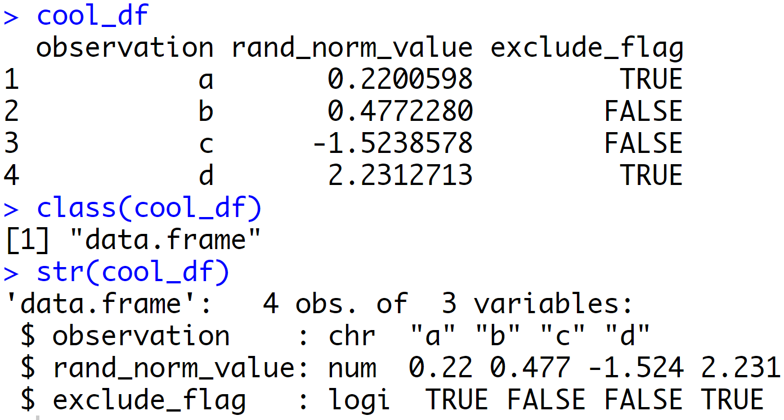
# example of data frame
cool_df <- data.frame(
# columns of data frame
observation = c("a", "b", "c", "d"),
rand_norm_value = rnorm(4),
exclude_flag = c(TRUE, FALSE, FALSE, TRUE),
# other options for data frame
row.names = NULL,
stringsAsFactors = FALSE
)
# examine data frame
cool_df
class(cool_df)
str(cool_df)

Slide 59
IMPORTING AND EXPORTING DATA
Importing Data
Use the read.csv() function to read in .csv files
Other read.* functions exist for various file formats
Watch the stringsAsFactors argument!
Exporting Data
Use the write.csv() function to save .csv files to your hard drive
Watch the row.names argument!

Slide 60
style guide
I am a stickler for nicely formatted code

Slide 61
style guide
Naming scripts:
basic-stuff.r
detail.r
weather-analysis.R
emerson-text-analysis.R
Which is good, which is bad?

Slide 62
style guide
Naming scripts:
Bad
Good
basic-stuff.r
detail.r
weather-analysis.R
emerson-text-analysis.R
Which is good, which is bad?

Slide 63
style guide
Naming objects:
naming_convention
naming.convention
namingconvention
namingConvention
NamingConvention
Which is good, which is bad?

Slide 64
style guide
Naming objects:
Good
Bad
naming_convention
naming.convention
namingconvention
namingConvention
NamingConvention
Which is good, which is bad?

Slide 65
style guide
Organization:
#################
# Download Data #
#################
lines of code here
###################
# Preprocess Data #
###################
lines of code here
########################
# Exploratory Analysis #
########################
lines of code here
lines of code here
lines of code here
lines of code here
lines of code here
lines of code here
lines of code here
lines of code here
lines of code here
lines of code here
lines of code here
lines of code here
lines of code here

Slide 66
style guide
Organization:
Good
Bad
#################
# Download Data #
#################
lines of code here
###################
# Preprocess Data #
###################
lines of code here
########################
# Exploratory Analysis #
########################
lines of code here
lines of code here
lines of code here
lines of code here
lines of code here
lines of code here
lines of code here
lines of code here
lines of code here
lines of code here
lines of code here
lines of code here
lines of code here

Slide 67
style guide
Code spacing:
average<-mean(feet/12+inches,na.rm=TRUE)
average <- mean(feet / 12 + inches, na.rm = TRUE)
Which is good, which is bad?

Slide 68
style guide
Code spacing:
Bad
Good
average<-mean(feet/12+inches,na.rm=TRUE)
average <- mean(feet / 12 + inches, na.rm = TRUE)
Which is good, which is bad?

Slide 69

what to remember

Slide 70
functions to remember
Operator/Function | Description
help(), ?, example() | Get help on functions and provide examples
getwd(), setwd() | Get and set your working directory
+, -, *, /, ^ | Arithmetic
<- | Assignment operator
ls(), rm() | list and remove objects in your global environment
install.packages(), library() | Install and load packages
vignette() | View/list package vignette

